Slide 1
The end of molecular dynamics era: Protein-Specific Conformation Generation Using Deep Learning

Slide 2





Our team members
Esraa Abdallah
Maram Reda
Elzahraa Saeed
Rana Rizk
Omar Mohammed

Slide 3


Collaboration with Proteinea and Nile University
Under Supervision of : Dr. Tamer Ibrahiem

Slide 4
Table of contents
01
Problem Definition
02
03
Introduction
Methodology
04
05
Results
Conclusion and future work

Slide 5
01
Problem Definition

Slide 6
Problem Definition
Proteins exist in dynamic states. Each state is called a confirmation where a conformation is a distinct 3D orientation of a protein structure at a given time.
The only high-accuracy computational approach to fulfill this is via molecular dynamics simulations(MD).
Instead of running an MD simulation for all the proteins, we can make a model that generates those conformations.
This project proposes replacing molecular dynamics simulations with a generative neural network trained on protein structures produced by MD simulation.

Slide 7
Introduction
02
MD Simulations
Autoencoder

Slide 8
Introduction
Proteins are flexible molecules, and their dynamics are intimately connected to their function.
Several methods have been developed to examine the structure of proteins in order to learn more about their molecular functions.
1. X-ray crystallography: Provide structure evidence at atomic resolution.
It locks the protein in a single well-defined conformation.
2. Nuclear magnetic resonance: Informs about dynamics.
Identify multiple states, in case that the molecule of
interest is not too large.

Slide 9
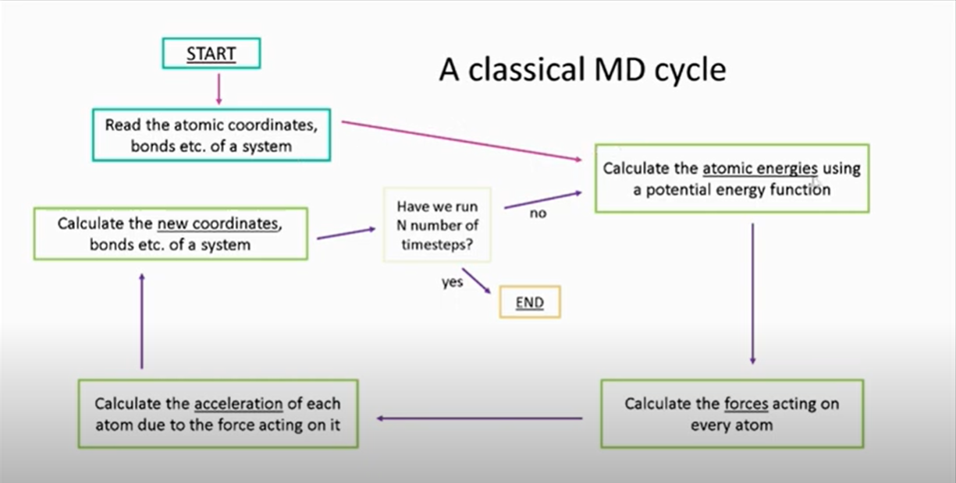
MD Simulation
Computational approaches like MD simulations characterize molecular conformational space by iteratively generating new structures based on atomic arrangement.
MD describes how each atom moves in a unit of time.
The classical MD Cycle:
Figure1:Classical MD Simulation
Challenge: The computational cost MD increases significantly lead to the limitation of
the size and timescales of simulations.

Slide 10
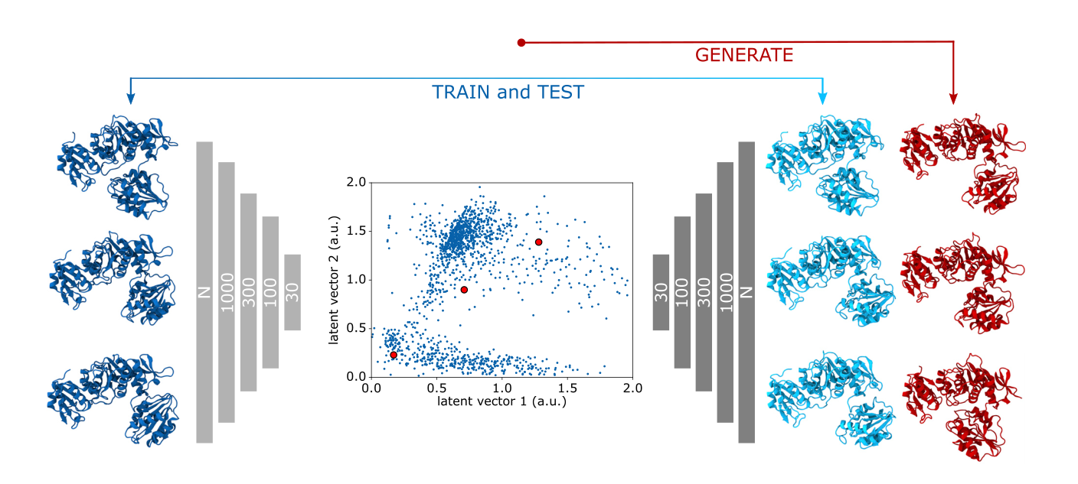
Deep Learning Model(Autoencoder)
Deep learning models such as autoencoders are solutions that can help to reduce the computational cost of MD simulations and used to predict molecular behavior.
The conformations generated by one or more protein MD simulations as examples to train an these models.
Autoencoders can generate new, realistic protein conformations complementing pre-existing data produced by MD simulations.
Figure2: Autoencoder Structure

Slide 11
METHODOLGY
03
MD simulations
Deep learning model

Slide 12
Proteins Used
1
2
3
4
2QKE
1FQ9
FGF2
2P23

Slide 13
PROTEIN PREPARATION
01
02
03
Removing heteroatoms “ligands” Chimera
Adding missing atoms Deep view
Adding missing hydrogens
Chimera

Slide 14
MD SIMULATION
- Generate topology files
- Energy minimization
To remove any remaining steric.
clashes. In this project, we used the steepest descent algorithm to minimize the energy of the system.
01
Specify the force field which was CHARMM27 and water model which was TIP3P.
03
.
-Equilibrate the system
-Solvate the protein
solvate the protein in a box of water molecules, we used the Simple Point Charge (SPC) water model.
By gradually increasing the temperature and pressure of the system to reach the desired temperature and pressure of the simulation.
02
04
Finally, perform the production MD simulation with 100 ns .

Slide 15
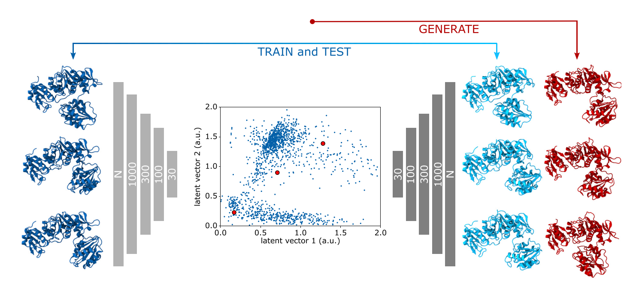
Methodology: Deep Learning
Deep Learning model:
Autoencoder model is an unsupervised model.
Consists of 3 parts:
- Encoder - latent vector - decoder
It is important to minimize the reconstruction error between input data and reconstructed output.

Slide 16
Methodology: Deep Learning
2) Languages and Libraries:
Python
Bash
Pytorch Framework
Pandas
Matplotlib
Sikit learn

Slide 17
Methodology: Deep Learning
3) Dataset:
The dataset is obtained from the Molecular Dynamics simulations for
- 2QKE
- 1FQ9
- 2P23
- FGF2
Input for the model is the trajectory file.
The positions for (N, C Alpha, C, and C Beta ) get extracted using a python script.
- 2QKE : 500 Conformations ---- 392 Atoms
- 1FQ9 : 1001 Conformations ---- 516 Atoms
- 2P23 : 975 Conformations ---- 544 Atoms
- FGF2 : 406 Conformations ---- 620 Atoms
The initial PDB pass through a python script to extract the Backbone.

Slide 18
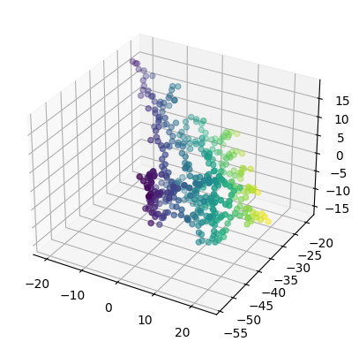
Methodology: Deep Learning
4) Data Loader:
The data was loaded in Batches where each batch size is 4 conformations.
The normalization wasn’t the best choice.
One Conformation for 2QKE

Slide 19
Methodology: Deep Learning
5) Alignment Using Kabsch Torch:
The input and reconstruct may be the same structure but with different rotations.
Used to align the input and reconstructed output together to find the optimal rotation.
This process helps to minimize the error between the input and output.
6) Batch Kabsch torch:
Takes the input and reconstructed output in batches so it can perform the aligning.

Slide 20
Methodology: Deep Learning
7) Model Architecture:
Encoder consists of 4 hidden layers.
Batch Normalization
RELU “ Rectified linear unit” Activation Function.
Latent vector with the dimension 100
Decoder consists of 4 hidden layers
Loss Function : Mean square error

Slide 21
Methodology: Deep Learning
7) Training:
Number of epochs : 450
Learning rate 5e-4 to control the step size of each iteration.
Training returns reconstructed output and input to perform the loss function on them.
After the training, the reconstructed outputs, as well as the inputs are converted into NPY.

Slide 22
Methodology: Deep Learning
8) Bash Scripts:
Iterate over the NPY files to convert them into PDB: Both NPY input and outputs.
iterate over the input and reconstruct structures pairs to calculate the RMSD.
iterate over all the inputs conformations and to calculate the RMSD between the 2 structures, generate a TSV file for each and concatenate it.
iterate over all the outputs conformations and to calculate the RMSD between the 2 structures, generate a TSV file for each and concatenate it.

Slide 23
Methodology: Deep Learning
9 ) Sampling:
sampling interpolation function to sample from the latent space.
linear interpolation to generate new samples between two conformations after encoding them into the latent vectors.
Then decode the output vectors to generate those new conformations.
Using the equation

Slide 24
Methodology: Deep Learning
Validation :
Cross Validation:
-- use the bash scripts to iterate over all the input / output pairs to calculate the RMSD for each pair.
-- plot the histogram for all the pairs.
Diversity:
-- use the bash scripts to iterate over all the inputs to calculate the RMSD for each pair and plot the histogram for all the pairs.
-- use the bash scripts to iterate over all the outputs to calculate the RMSD for each pair and plot the histogram for all the pairs.

Slide 25
Methodology: Deep Learning
-- DSSP (Dictionary of secondary structures of proteins):
Contains information about secondary structure of each residue including its position in
-- protein sequence
-- amino acid identity
-- secondary structure type such as H for alpha helix, E for beta sheets and c for coils
Analysis:
-- Q3: metric to evaluate the accuracy the secondary structure.
-- It measures the proportion of residues in a protein whose predicted secondary structure type matches the true secondary structure type, based on a reference dataset such as a DSSP file.

Slide 26
Results
04
MD Simulation
Autoencoder Model

Slide 27
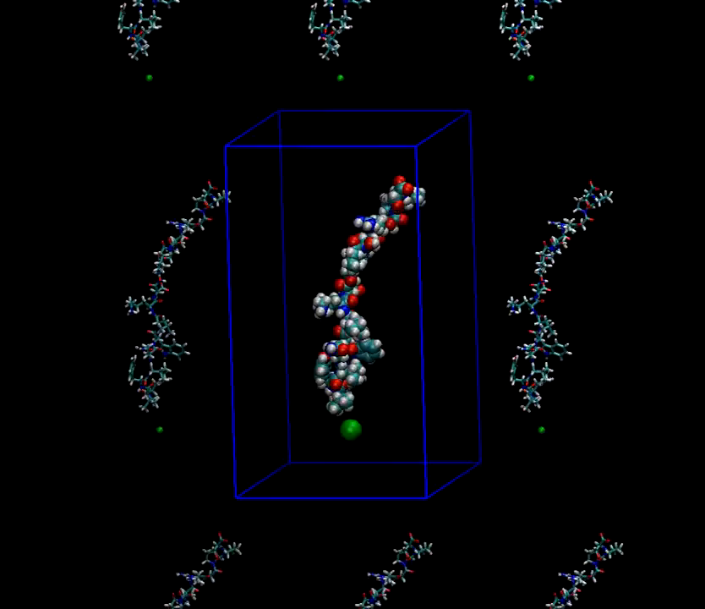
MD simulation
02
Extracting Backbones
Trajectories Centring
01
03
Taking frames every 100ps
Extracting a new PDB file but whole frames or whole pdb file will not be used.
Pdbs will be extracted that contains a new group containing only backbone (tertiary structure) (CA, C, N) + CB.
To take frames every 100ps correctly, we needed to make control over atoms so it won’t go free
It is an important step, to take frames for the Deep learning training part
skipping here is good and without it, this will extract billions of pdbs and total simulation will be thousand of ps and skip 100 ps it is nothing
Clustering or took representative it will affect our data and will not be valid for training our model “data will be decreased”.
Figure3: traj_center

Slide 28
Autoencoder Model
We needed to Convert timeframes coordinates to NumPy array format so that, model could deal with it.
For the first step on this model, we extracted number of atoms and its conformations for each protein, the conformation of a protein refers to its 3D shape and arrangement of atoms this step results :
2QKE: number of atoms: 392 , number of conformations : 500.
FGF2: number of atoms: 620 , number of conformations : 406.
1FQ9: number of atoms: 516 , number of conformations: 1001.
2P23: number of atoms: 544 , number of conformations: 975

Slide 29
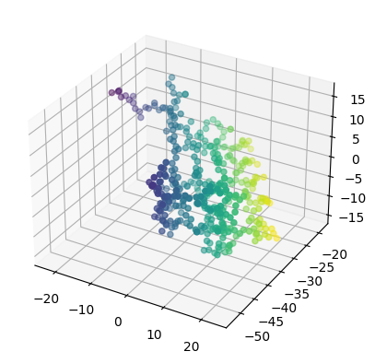
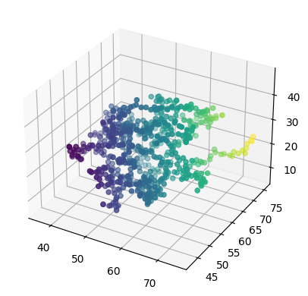
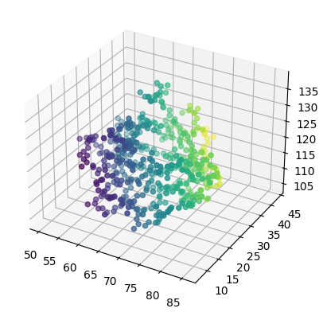
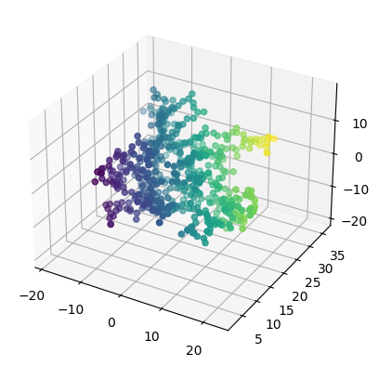
Visualize all array
We needed to visualize all arrays to make sure that all trajectory files entered correctly, and it results each proteins’ structure shape.
2QKE
FGF2
1Fq9
2P23
Figure4: all_proteins_array

Slide 30
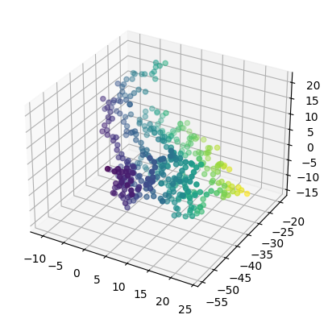
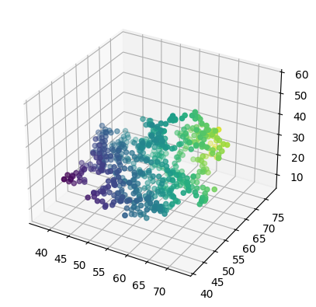
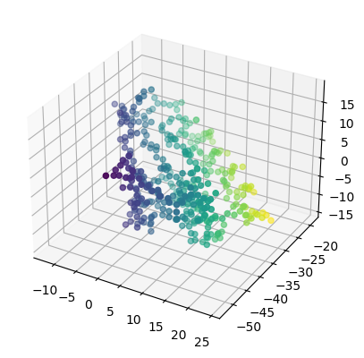
Dataset and Dataloader
A data loader in PyTorch is a utility that helps to load data in batches for efficient processing during training our model, the results of a data loader were batches of data that can be fed into a machine learning model.
2QKE
FGF2
1Fq9
2P23
Figure5: all_proteins_generated_samples

Slide 31
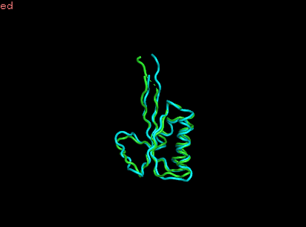
Training Data: Validation
2QKE Protein
1- Reconstructed after training:
Figure6:Reconstracted_2QKE
2- Loss Function:
For 2QKE Protein loss function was 0.6 which is very good after training the whole data with 450 iterations

Slide 32
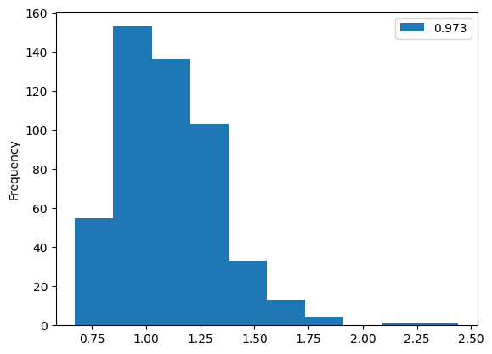
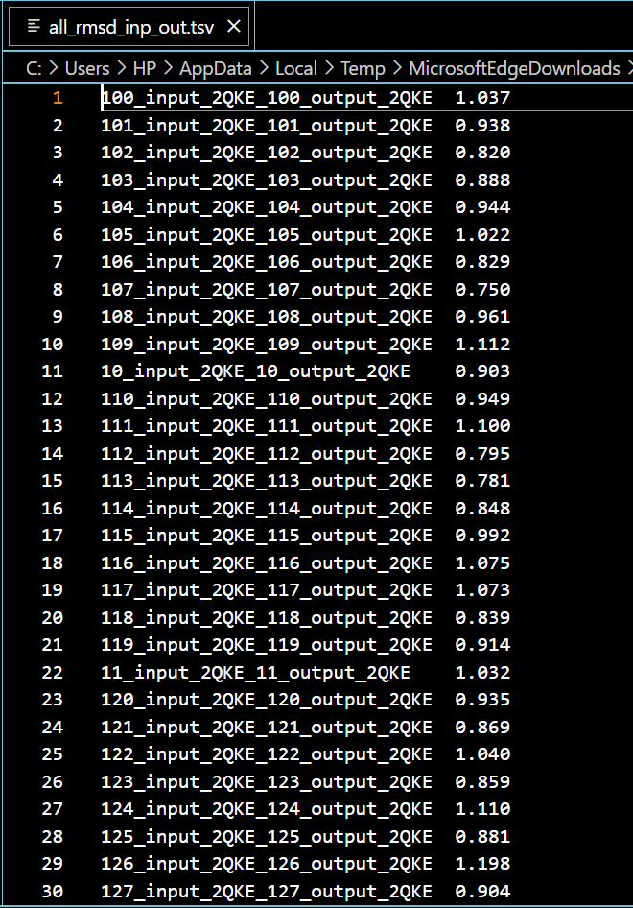
Training Data: Validation
2QKE Protein
3- Cross Validation :
To compare RMSD for all inputs and outputs after training - smaller RMSD than 2 the better it gets- for example, RMSD for input_235 and output _235 for 2QKE was 0.857 A⁰.
4-Concatenation of TSV files for inputs and outputs
Best RMSD (0.75 A˚ RMSD).
Average (1.50 A˚ RMSD).
Worst (2.50 RMSD A˚).
Figure7.1:Histogram_RMSD_2QKE
Figure7.2:RMSD_TSV_2QKE

Slide 33
Training Data: Validation
2QKE Protein
5- Diversity :
For diversity step, it is important for developing accurate and robust model for protein structure prediction, we also compared RMSDs between inputs_inputs and outputs_outputs.
Best RMSD (0.75 A˚ RMSD).
Average (1.50 A˚ RMSD) and Worst (2.50 RMSD A˚).
Figure8.1:input_input_RMSD_diversity_2QKE
Figure8.2:output_output_RMSD_diversity_2QKE

Slide 34
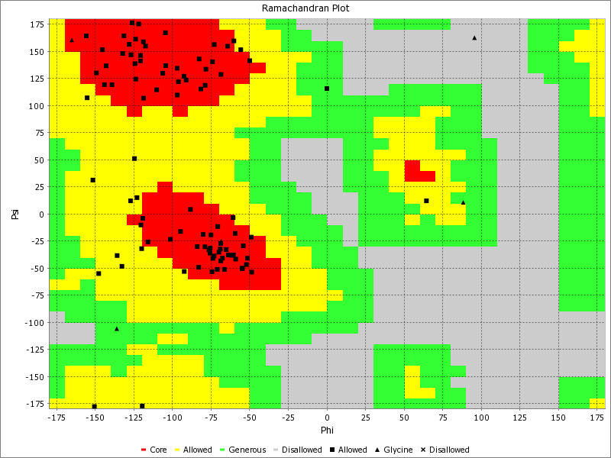

Training Data: Validation
2QKE Protein
6- Ramachandran Plot :
It is used in the development and validation of computational methods for protein structure prediction. The following figures show that input and output in alpha-helix and beta-sheets (red region) are almost the same.
Figure9.1:input_input_RMSD_RP_2QKE
Figure9.2:output_output_RMSD_RP_2QKE

Slide 35
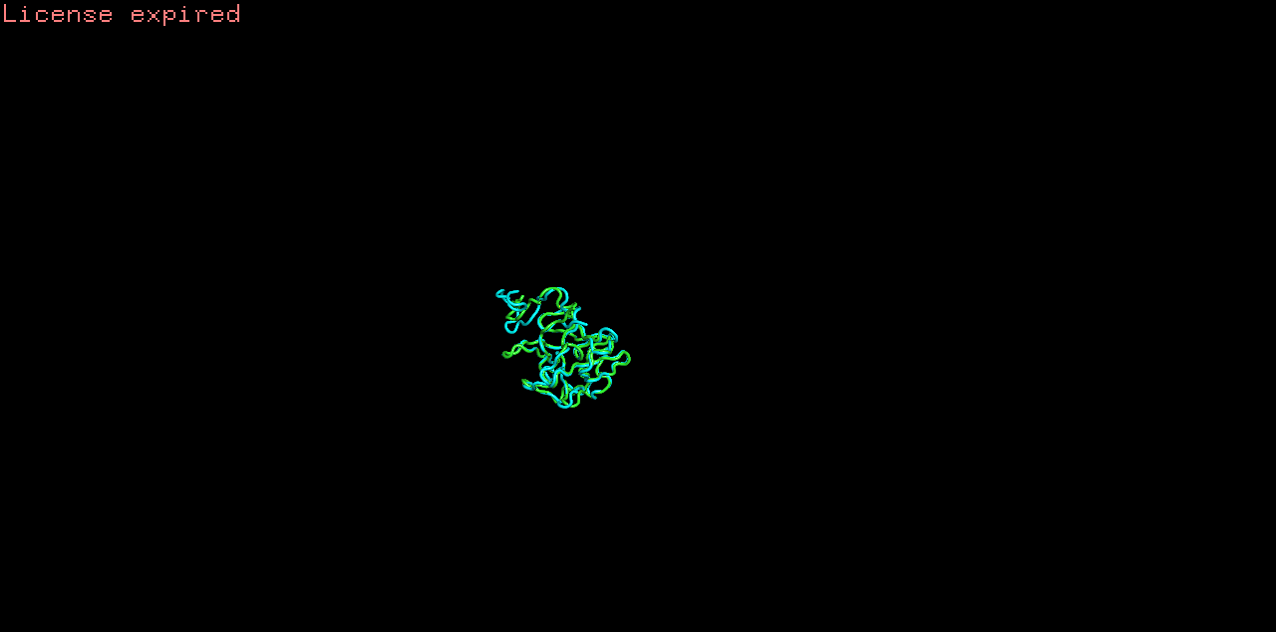
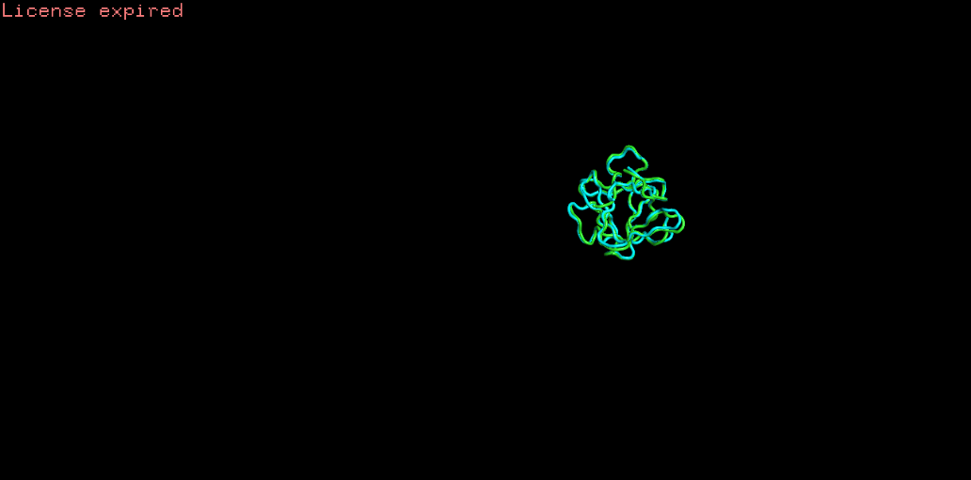
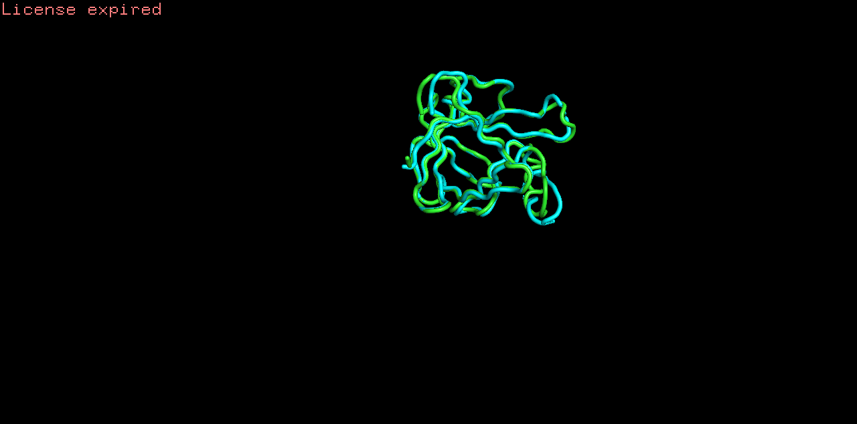
Training Data: Validation
FGF2,1Fq9 and 2P23 Proteins
1- Reconstructed after training and Loss Function:
For each Protein loss function was 2.8,0.5,0.3 which is very good after training the whole data with 350 to 450 iterations
Figure10.1:Reconstracted_FGF2
Figure10.2:Reconstracted_1Fq9
Figure10.3:Reconstracted_2P23

Slide 36
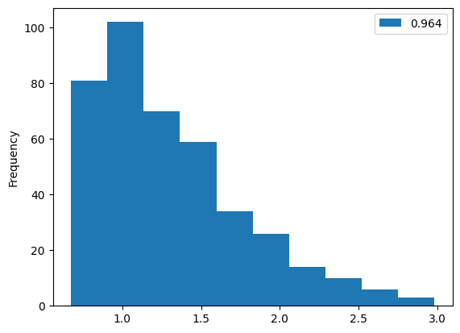
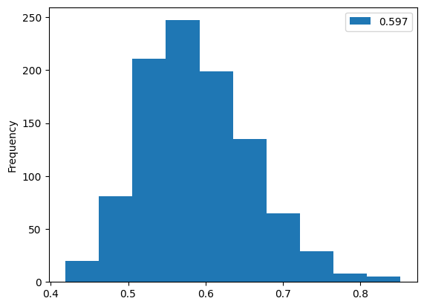
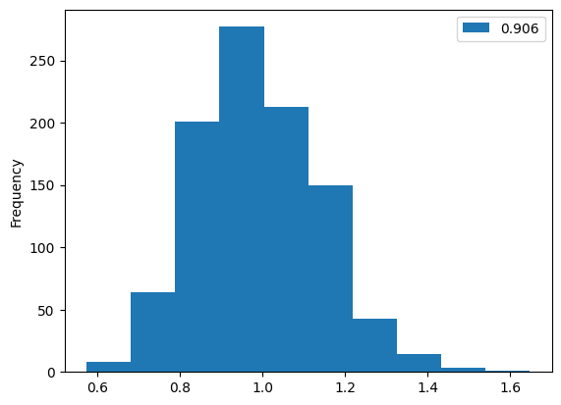
Training Data: Validation
FGF2,1Fq9 and 2P23 Proteins
1- Cross Validation:
RMSD for input_280 and output _280 for FGF2 was 0.899 A˚
RMSD for input_135 and output _135 for 1Fq9 was 0.507 A˚
RMSD for input_898 and output _898 for 2P23 was 0.87A˚
2- Concatenation:
For FGF2 , the best ( > 1.0 A˚ RMSD), average (2.0 A˚ RMSD), and worst (3.0 A˚ RMSD ).
For 1Fq9 , the best (0.4 A˚ RMSD), average (0.6 A˚ RMSD), and worst ( < 0.8 A˚ RMSD ).
For 2P23 , the best ( 0.6 A˚ RMSD), average (1.0 A˚ RMSD), and worst ( 1.6 A˚ RMSD).
Figure11.1:RMSD_FGF2
Figure11.2:RMSD_1Fq9
Figure11.3:RMSD_2P23

Slide 37
Training Data: Validation
FGF2, 1Fq9 and 2P23 Proteins
3- Diversity :
Generated RMSDs between inputs_inputs and outputs_outputs.
For FGF2 , the best ( > 1.0 A˚ RMSD), average (2.0 A˚ RMSD), and worst (3.0 A˚ RMSD ).
For 1Fq9 , the best (0.4 A˚ RMSD), average (0.6 A˚ RMSD), and worst ( < 0.8 A˚ RMSD ).
For 2P23 , the best ( 0.6 A˚ RMSD), average (1.0 A˚ RMSD), and worst ( 1.6 A˚ RMSD).
Figure12.1:input_input_RMSD_1Fq9
Figure12.2:input_input_RMSD_FGF2

Slide 38
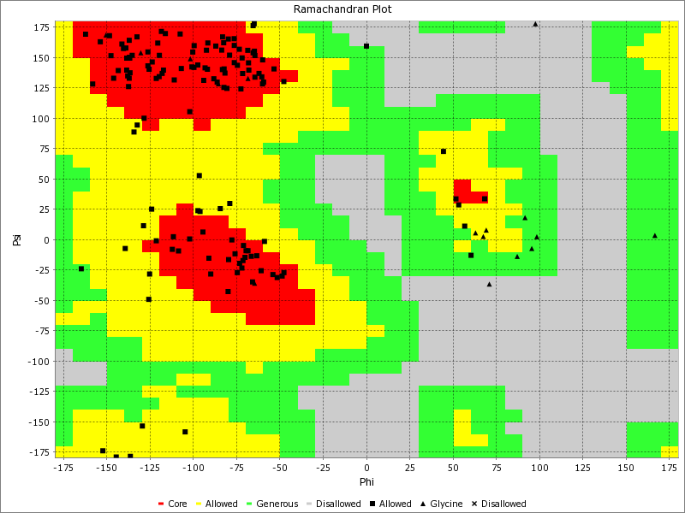

Training Data: Validation
FGF2, 1Fq9 and 2P23 Proteins
4- Ramachandran Plot :
The following figures show that input and output in alpha-helix and beta-sheets (red region) are almost the same.
Figure13.1:input_input_RMSD_RP_FGF2
Figure13.2:output_output_RMSD_RP_2P23

Slide 39
Training Data: Validation
DSSP "Dictionary of Secondary Structure of Proteins"
The secondary structure assignments in the DSSP output file can be used to evaluate the accuracy of computational methods that predict protein secondary structure .
The Q3 score matrix is calculated as the number of correctly predicted residues divided by the total number of residues.
Based on that, we have checked the accuracy for some proteins. Accuracy has been resulting 0.94 for some proteins.

Slide 40
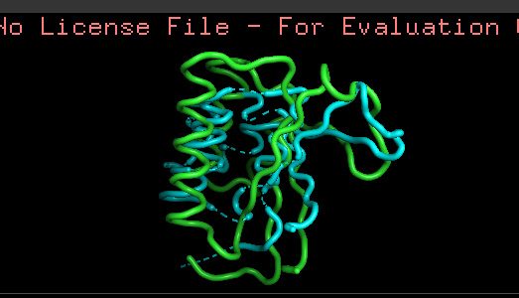
Training Data: Validation
Sampling
Figure14:sampling

Slide 41
Conclusion and future work
05

Slide 42
1. Goal: Improve sampling of molecular conformational space and replace molecular dynamics simulation 2. Use generative neural networks to improve sampling of molecular conformational space 3. Auto encoder trained on protein MD simulation-generated conformations 4. Importance of Substantial Sampling: Accurate results required to justify experimental data or forecast outcomes before trials 5. Use of Generative Neural Networks: Generate new, realistic protein conformations complementing existing ones 6. Application: Discover collective variables for extracting kinetic information or directing selection of underexplored regions
Conclusion

Slide 43

Future Work
Incorporate additional modules for further improvement:
Develop user-friendly tools for researchers to access and leverage the model easily
1. Future direction: Plan to develop a web-based tool
2. Tool allows researchers to input proteins and obtain accurate and efficient predictions of new conformations
Generate candidate subunits for protein docking

Slide 44
References
[1] Achlioptas, P., Diamanti, O., Mitliagkas, I., and Guibas, L. (2017). Learning representations and generative models for 3D point clouds. ArXiv, 1707.02392.
[2] Bahar, I., et al. "What is the root mean square deviation (RMSD) and how is it calculated?" Proteins: Structure, Function, and Bioinformatics 78.2 (2010): 203-214
[3] Chen, H., et al. "A review of protein structure preprocessing methods." Briefings in bioinformatics 19.2 (2018): 226-241.
[4] Chu, X., Gan, L., Wang, E., and Wang, J. (2013). Quantifying the topography of the intrinsic energy landscape of flexible biomolecular recognition. Proc. Natl. Acad. Sci. U S A 110, E2342– E2351.
[5] Li, Y., et al. "Periodic boundary conditions in molecular dynamics simulations of proteins: Artifacts, corrections, and applications." Journal of chemical theory and computation 15.12 (2019): 6327-6346.
[6] Matteo T. Degiacomi ,Department of Chemistry, Durham University, South Road, Durham DH1 3LE, UK 2Lead ,https://doi.org/10.1016/j.str.2019.03.018
[7] Wang, Y., et al. "Trajectories centering and frame selection algorithms for extracting meaningful information from molecular dynamics simulations." Journal of computational chemistry 41.24 (2020): 2378-2388.
[8] Xu, D., et al. "Backbone conformation analysis of proteins: A review." Journal of chemical information and modeling 61.1 (2021): 36-53

Slide 45
THANKS
Do you have any questions?

